Slide 1
COVID-19 Successes, Challenges, and Lessons Learnt
Thomas Oates PhD MRCP
Departments of General Medicine & Nephrology
Royal London Hospital, UK
Ahvaz Jundishapur University of Medical Sciences
COVID-19 Webinar, 11 Feb 2021

Slide 2
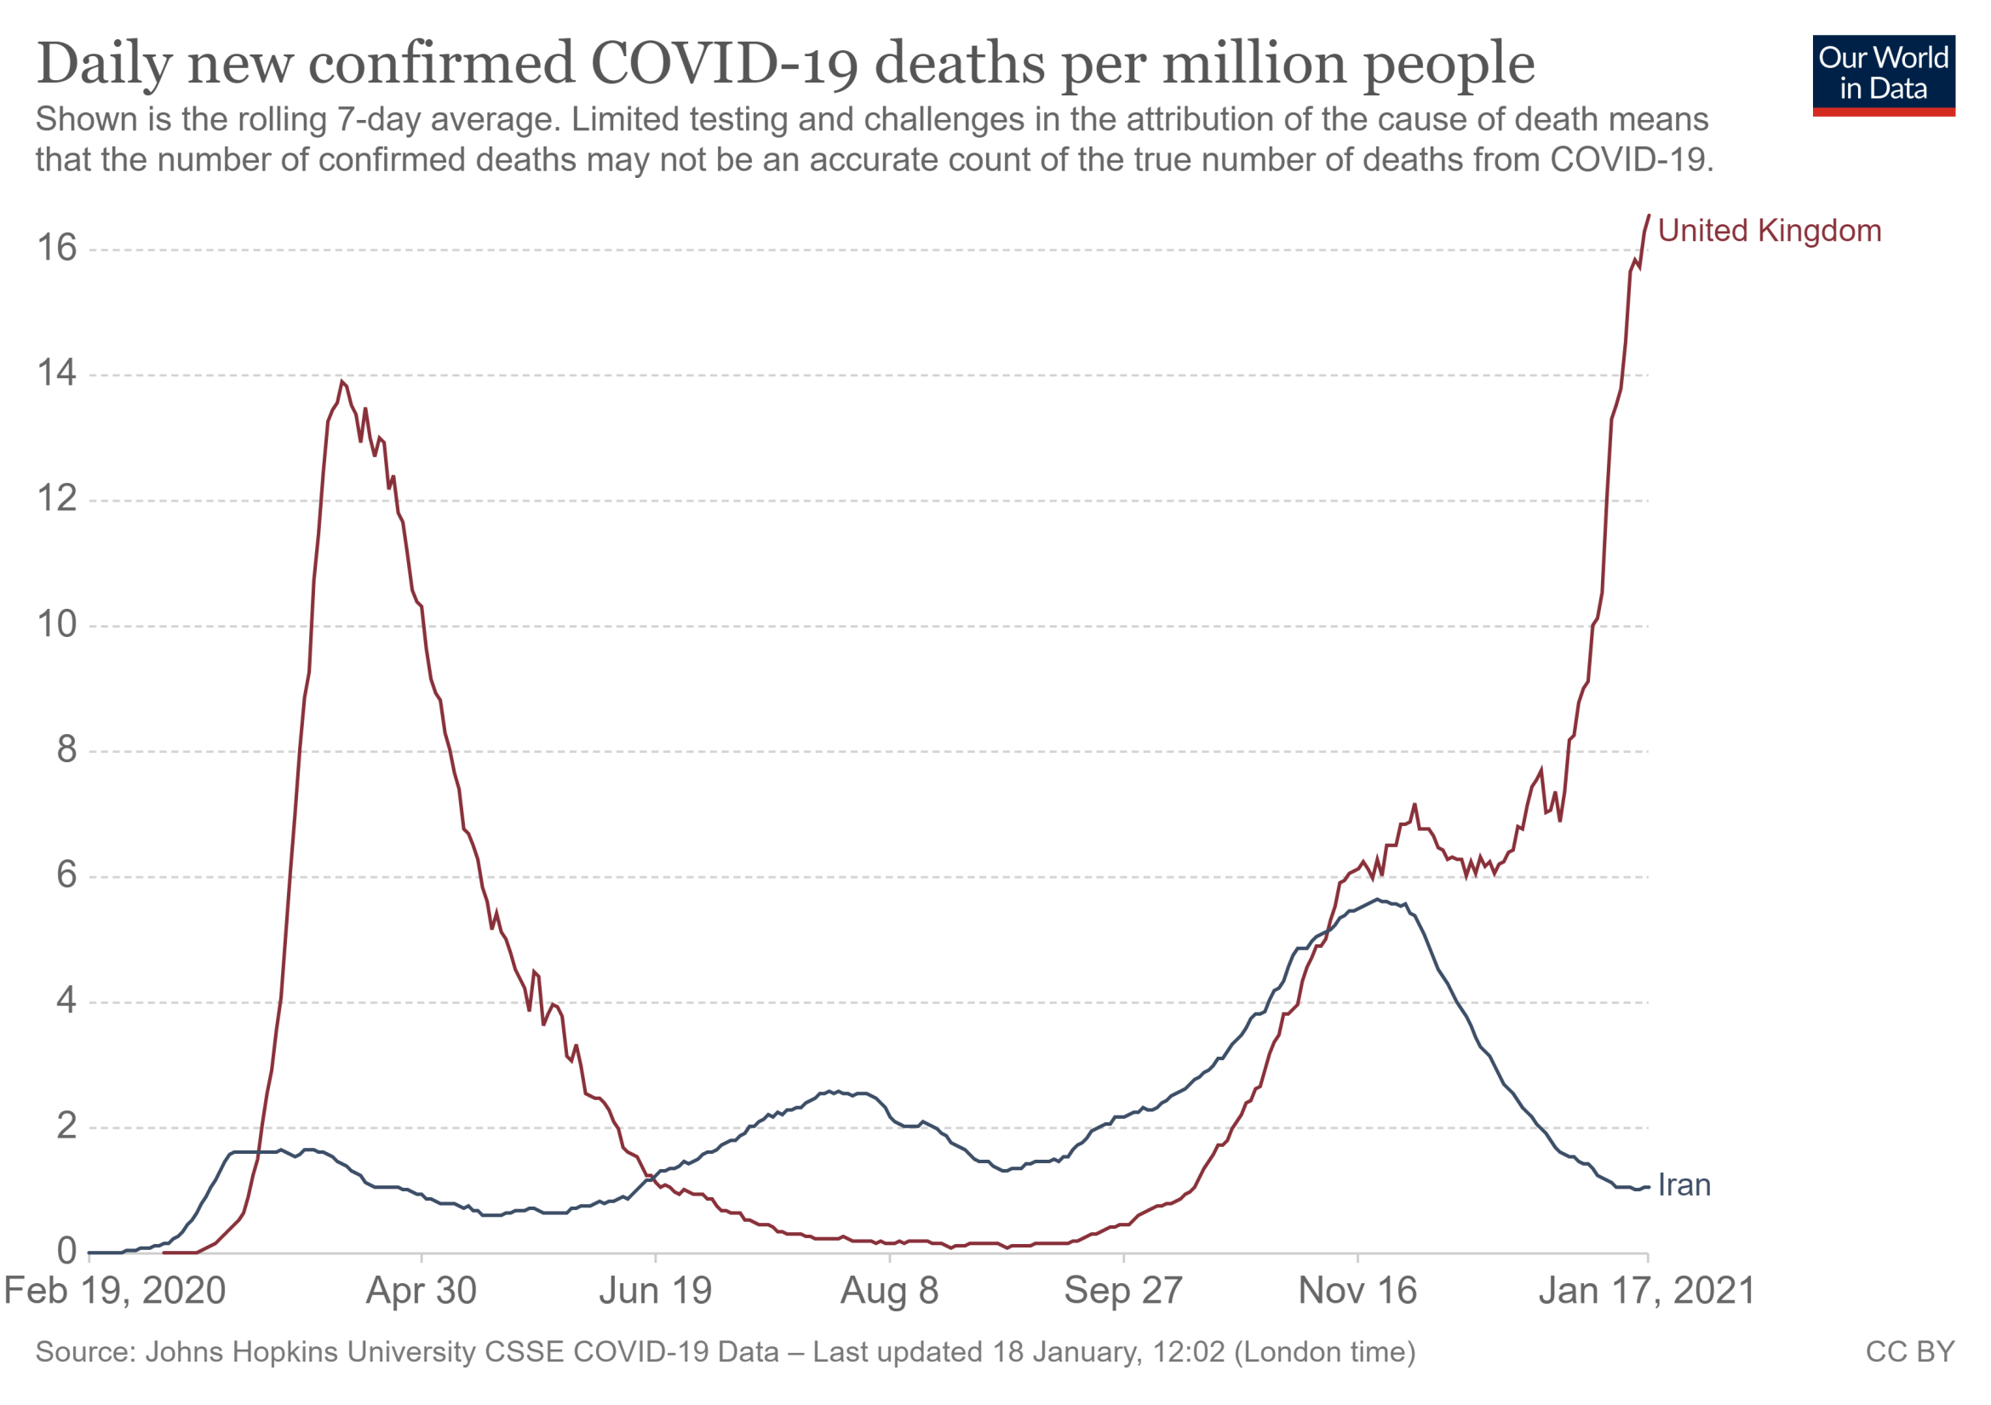

Slide 3

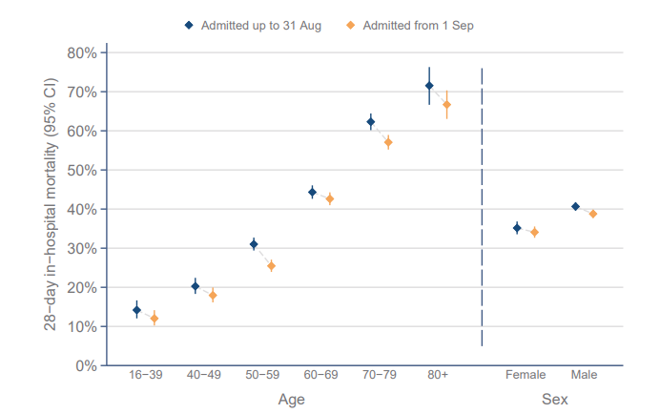
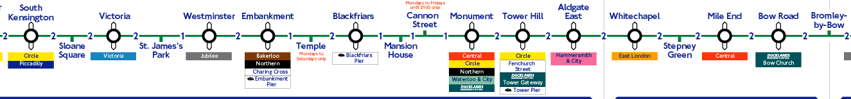
Life Expectancy
86
85
86
86
80
80
81
80

Slide 4
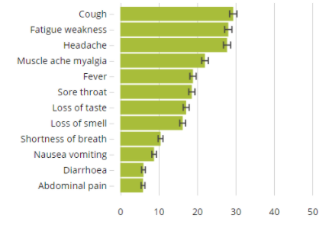
Natural History
Symptom
Severity
Contagion
Contagious
No
symptoms
No symptoms
30%
Contagious
No symptoms
Mild/moderate symptoms
Mild/Moderate
Symptoms
55%
Contagious
Severe
Symptoms
10%
No symptoms
Severe symptoms
Hospitalization
Contagious
Critical
Symptoms
5%
No symptoms
Severe symptoms
ICU/Ventilation
Dead
Days
0 1 2 3 4 5 6 7 8 9 10 11 12 13 14 15 16 17 18 19 20 21 22 23 24 25

Slide 5
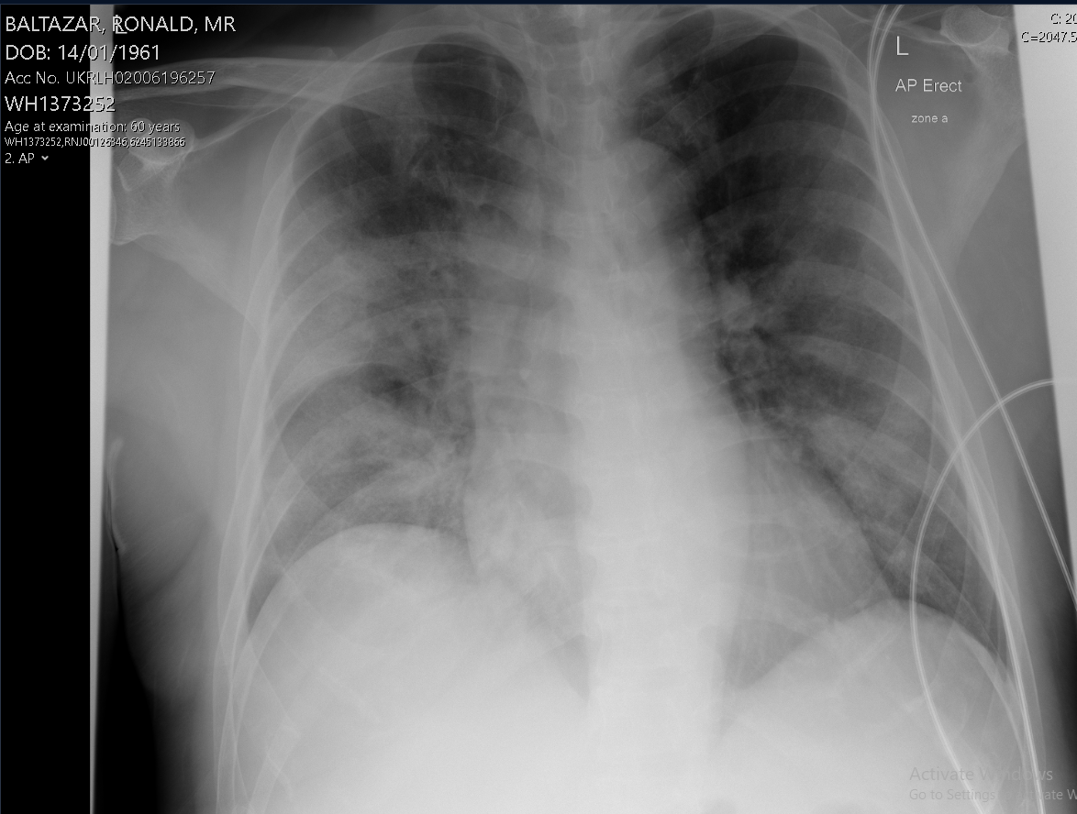
60 M
D10 symptoms - dry cough & fevers
Now worsening SOB for last 1 day
Chest pain only on coughing, not at rest
Hypertension
T2DM
Metformin 500mg BD
Amlodipine 10mg
Ramipril 10mg
35 br/min
O2 sats 93 % on 60 % 50L HFNO
150/87 mmHg
HR 99 bpm

Slide 6
Do we have to admit everyone?

Slide 7
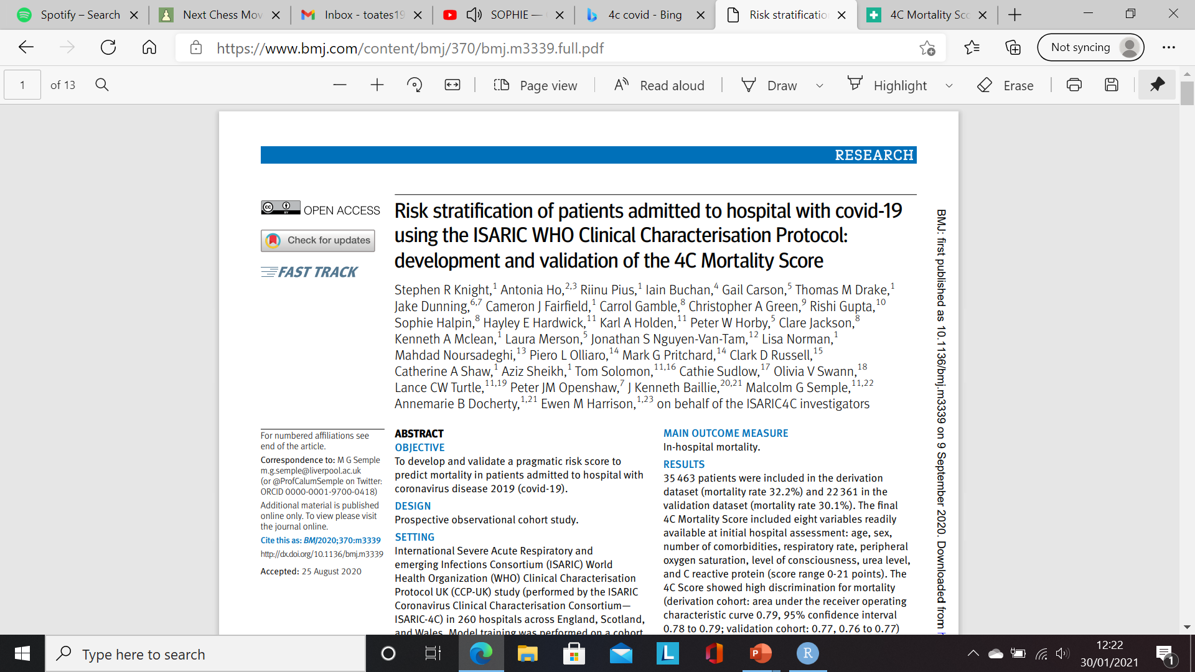
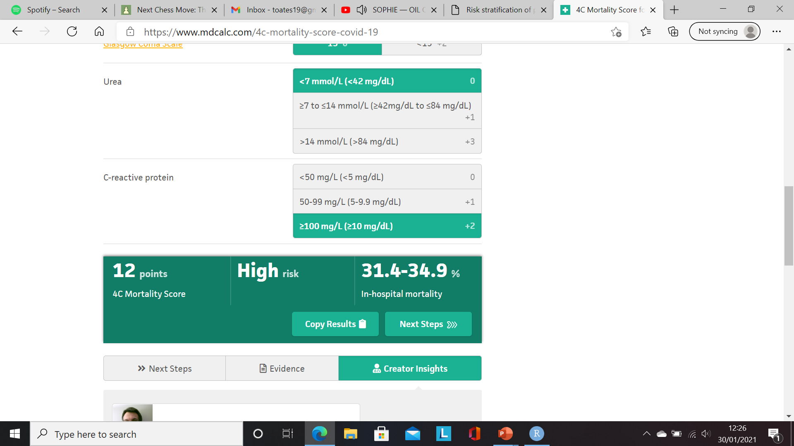
Risk Stratification
Age
Sex
Number of comorbidities
RR
Oxygen sats on air
GCS
Urea
CRP

Slide 8

Which Treatments & For Whom?
What we “know” works
What we also use
What is being examined
Tocilizumab
Aspirin
Colchicine
mAbs
Oxygen
Resp support
Dexamethasone
Antibiotics
VTE prophylaxis
Remdesivir
Tocilizumab
What we know does not work
Azithromycin
Hydroxychloroquine
Lopinavir–ritonavir

Slide 9
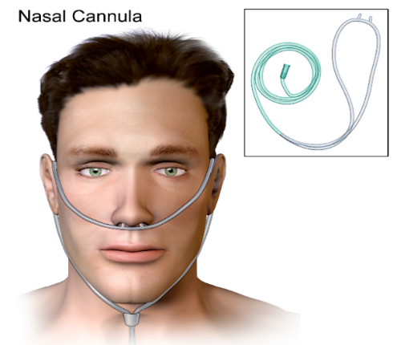
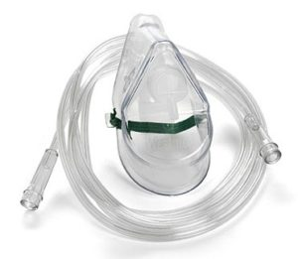
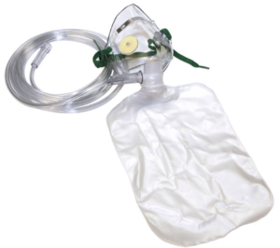
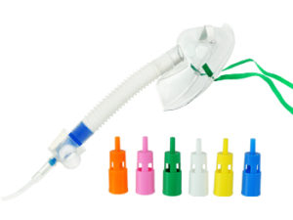
Oxygen
Nasal cannulae | Simple face mask | Non-rebreather mask | Venturi Mask
Delivers low to medium O₂ conc Adjustable flow gives wide O₂ conc range (e.g. flow rate 1-6L/min gives FiO2 from ∼24% to ∼50%) No risk of rebreathing of CO₂ May cause nasal irritation | O₂ conc = 60 - 90% O2 conc. Changed by altering O2 flows between 5 and 10L/min Not suitable for patients with hypercapnic respiratory failure | High O₂ conc therapy O₂ conc. = 60 - 90% when used at a flow rate of 15 L/min Most suitable for trauma & emergency use | Venturi masks will give accurate O2 conc. Available O₂ conc: 24%, 28%, 31%, 35%, 40% & 60%. 24% & 28% Venturi masks are recommended for those at risk of CO₂ retention

Slide 10
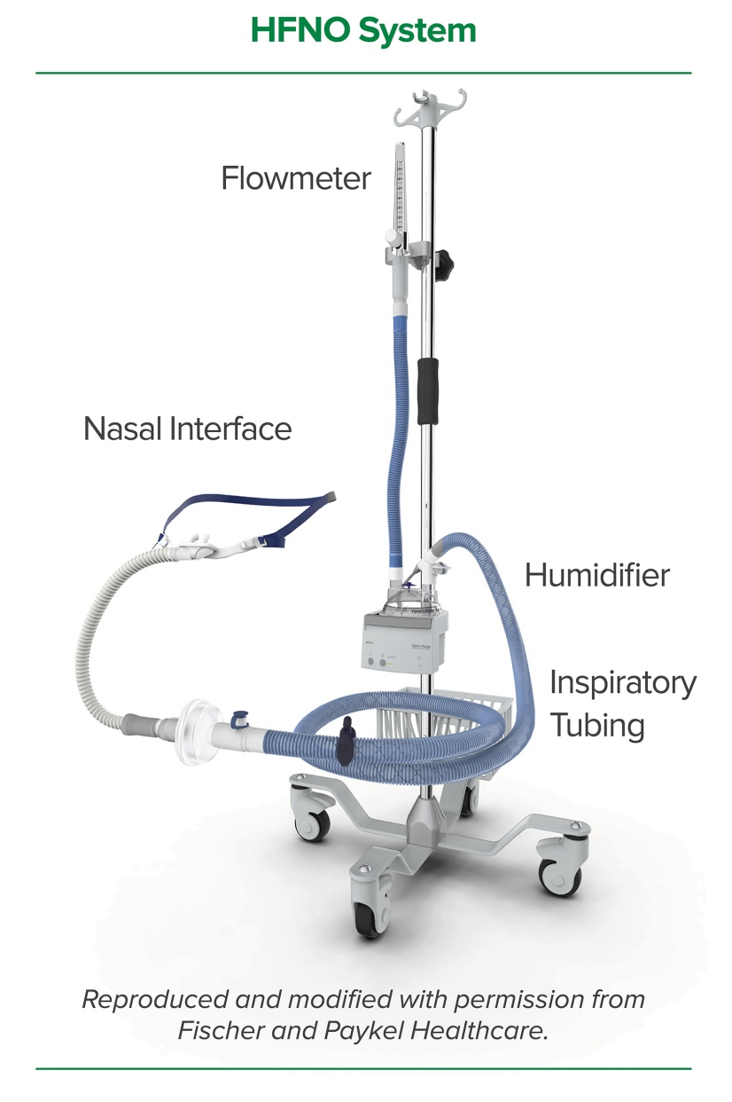
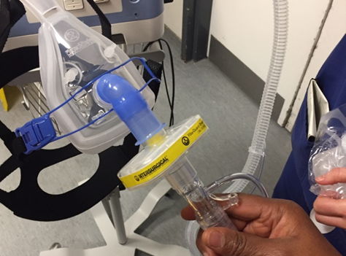
“Oxygen Plus” Devices
HFNO
Capable of delivering up to 100% humidified and heated oxygen at a flow rate of up to 60 L/min
CPAP
Form of non-invasive positive pressure ventilation through which a constant level of pressure above atmospheric pressure is applied to the airways

Slide 11
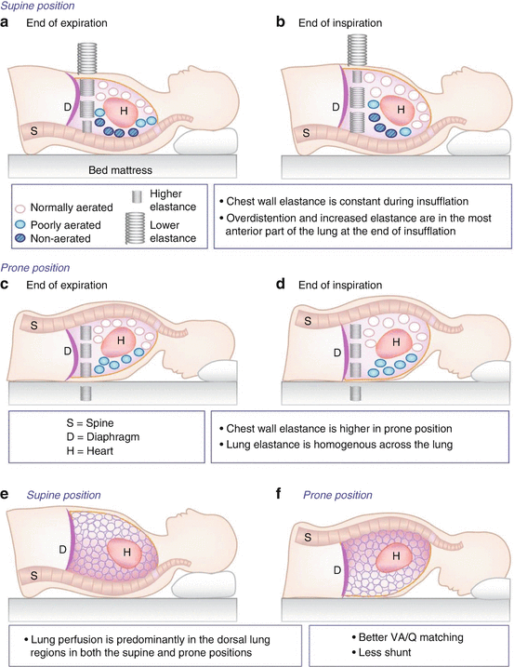
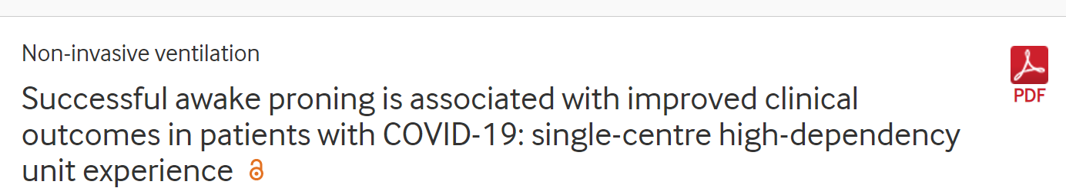
Conscious (Awake) Proning
Supine
Prone

Slide 12
Approach to Oxygenation Management
Nasal Specs
Venturi Mask
(24% -> 40% -> 60%)
NRB
HFNO
CPAP
Ventilation
What are the appropriate ceilings of care?
4C score
Clinical Frailty Score
RR ≥ 20bpm + SpO2<94%
Only for those who are at ceiling?
RR ≥ 30bpm + SpO₂≤90%
on FiO₂ >40%
Frat et al., NEJM 2015; Guy et al., ERJ 2020
RR ≥ 30bpm + SpO₂<90%
on FiO₂ 60%
Ashish et al., BMJ Open Resp Res 2020

Slide 13
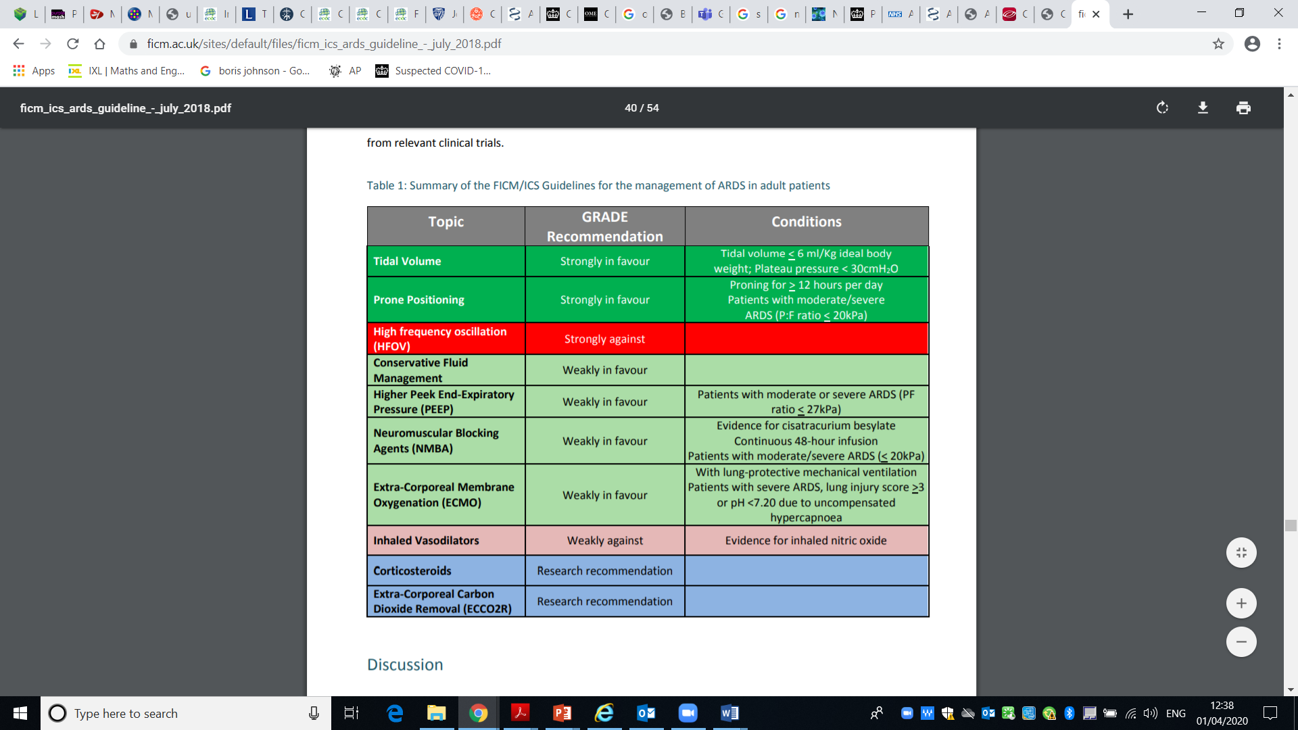
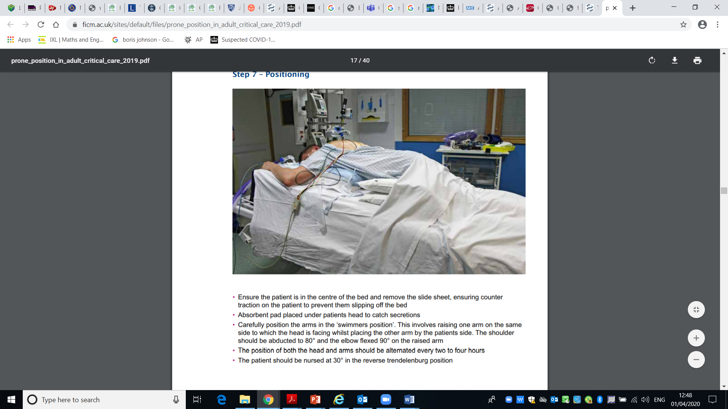
Invasive Mechanical Ventilation
Where mechanical ventilation is required, the use of low tidal volumes (< 6 ml/kg ideal body weight) and airway pressures (plateau pressure < 30 cmH2O) is recommended
Prone positioning is recommended for at least 12 hours per day (preferred 16-18 hours/day)

Slide 14
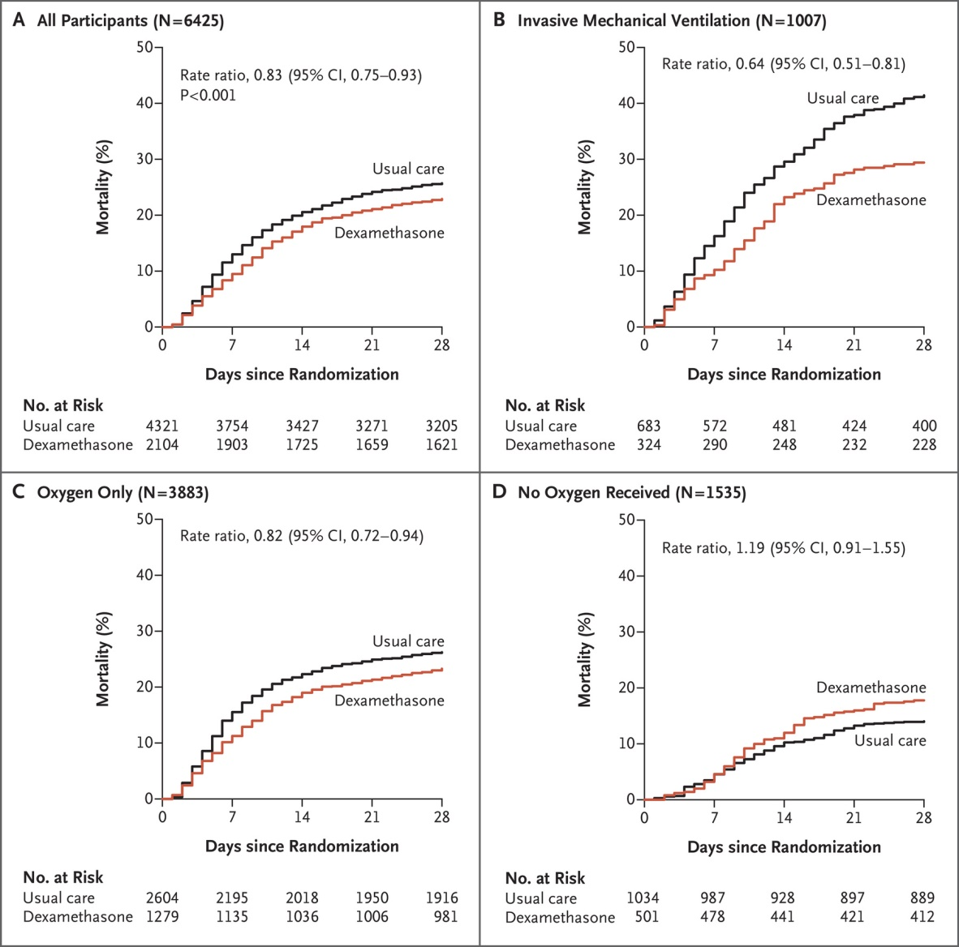
Dexamethasone
Up to 10 days of Dexamethasone reduced 28d mortality by:
One third in ventilated pts
One fifth in pts receiving oxygen
Things to Consider
Blood Glucose
Delirium
What if the patient isn’t better after 10 days?
Wean or stop?
Recovery Group, NEJM, 2020

Slide 15
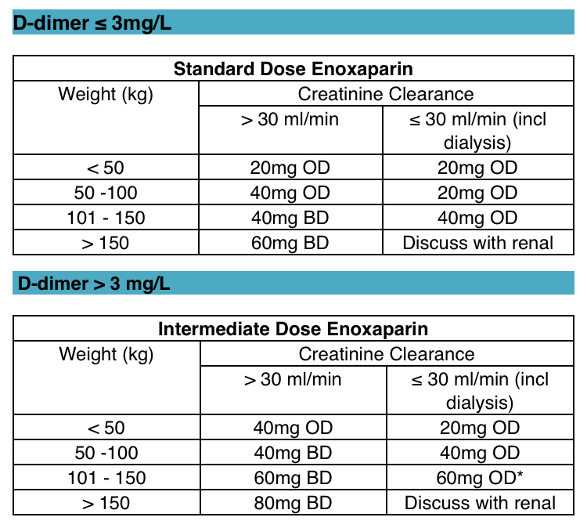
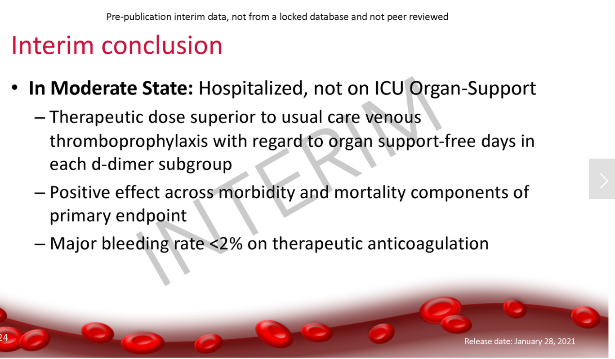
Venous Thromboembolism (VTE)
Very common in pts with covid-19
Consider CTPA
If prophylaxis used in hospital & decreased mobility in 14 days after discharge expected
Discharge with prophyalxis (DOAC or LMWH)
HOWEVER

Slide 16
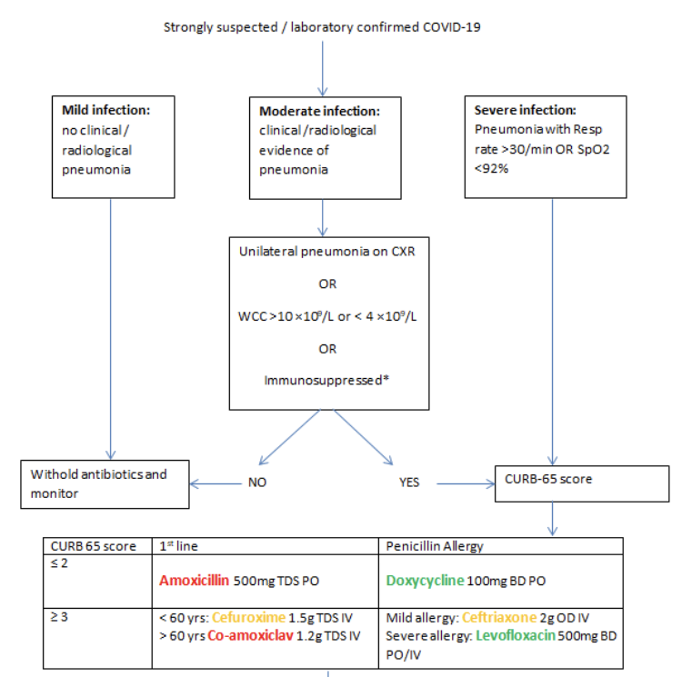
Antibiotics
Bacterial infection in pts with covid-19 pneumonia is estimated to be low 3.5-6% at admission
2ary infection may occur in about 15% with rates highest in those on mechanical ventilation
Community atypicals appear very low
Langford et al., Clin Microbiol & Inf, 2020

Slide 17
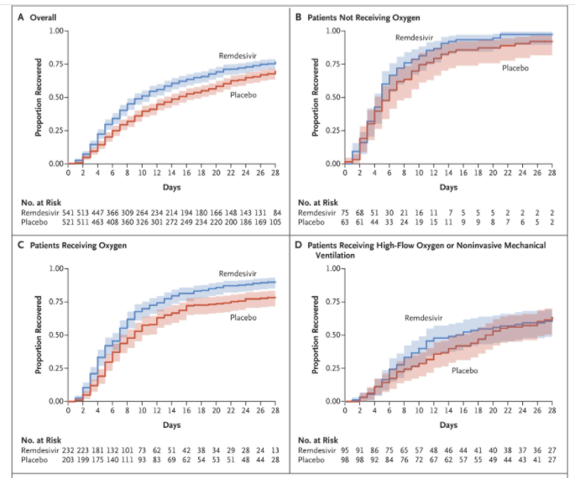
Remdesivir
Up to 10 days of Remdesivir shortened time to recovery:
Only in those on standard oxygen
Treatment Criteria
>12yo & >40kg
On oxygen
eGFR >30ml/min
AST/ALT < 5 x ULN & No CLD
4C score >= 4
Within 10 days of symptom onset
Beigel et al., NEJM, 2020

Slide 18
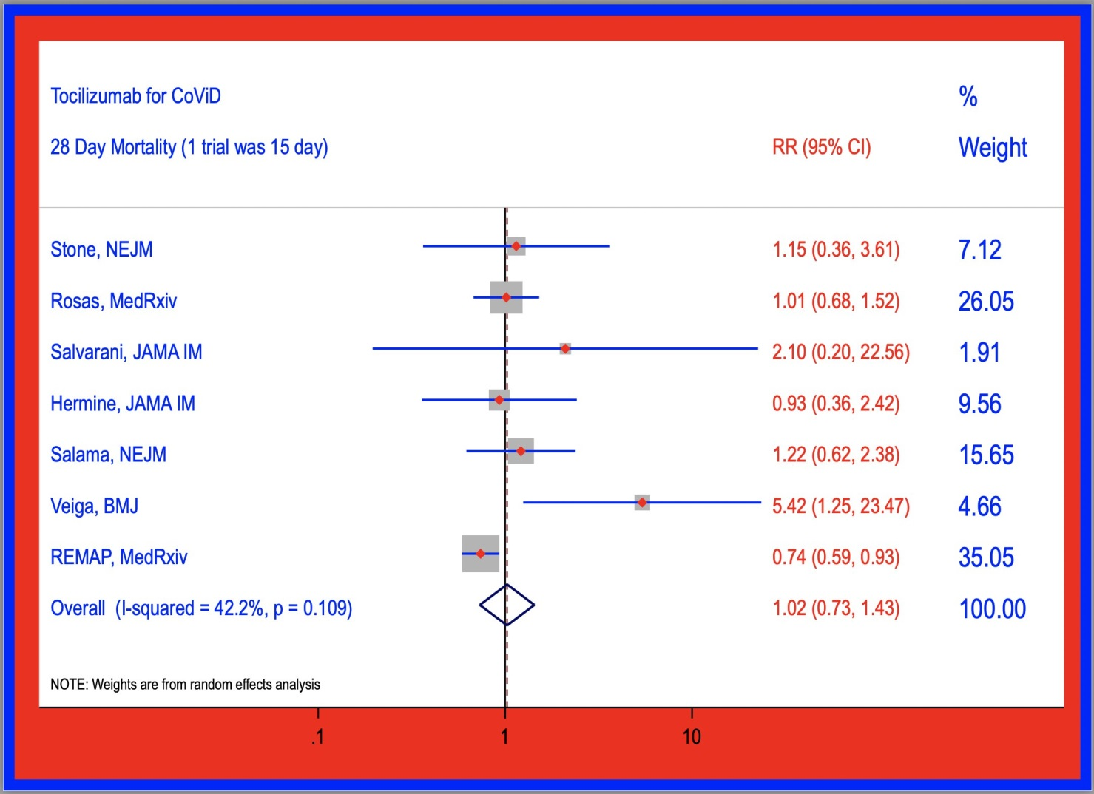
Tocilizumab
Many small studies based on the “cytokine storm” hypothesis
REMAP-CAP has driven move to use
RECOVERY may change this
Treatment Criteria
Requires advanced resp support
No more than 24h since starting 1
Low prob of other active infection
CRP > 75, Plt > 50, neuts > 2
Not on immunosuppression
https://twitter.com/mikejohansenmd/status/1352454133517869058?s=20

Slide 19
Non-Medical Issues
Do you have adequate PPE?
Can relatives communicate with their loved ones? – FaceTime – Volunteers/Students
Are you supporting your staff?
Do you have enough staff?
Mobilising from elsewhere
Supporting those outside their comfort zone – Supporting Juniors
Space – What space can you commandeer? How safe is it?
Safely cancelling elective work? Ramping back up again afterwards
Patient flow
Communication – In full PPE!
Radios
WhatsApp
Meetings – Teams, Zoom, F2F

Slide 20
Acknowledgments
Royal London Hospital
Acute medicine
ED
Respiratory Medicine
Critical Care
Especially Dr Will Ricketts to whom many of these slides belong

